Slide 1
Android Application Development Setup

Slide 2
What you need for this Android Application Developmen
A Computer (Yeah Only A Computer)

Slide 3
What you should already know before starting?
JAVA Programming Language. You should know the basics of JAVA.

Slide 4
Software Requirements
Java Development Kit (JDK)
Android Studio with SDK

Slide 5
Installing Java Development Kit
First we need to install JDK. So get the JDK from this link.
In my case I have downloaded jdk8 64bit for windows, because I am using Windows Operating System
Install JDK (next -> next -> next -> finish as we always do :P)
Now we need to set an environment variable

Slide 6
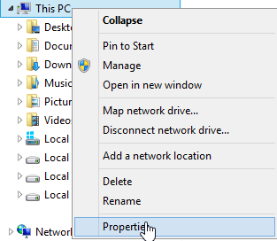
Setting JAVA_HOME variable
Right click on My Computer (This PC) and click on properties

Slide 7
A window will open, from left click on Advanced System Settings

Slide 8
Now from the new window that will open click on environment variables

Slide 9
Now from the new window in System Variables click on new

Slide 10
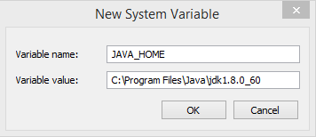
Cont..
Now in Variable Name write ‘JAVA_HOME’ and in value copy the path of your JDK Installation directory usually inside C:\Program Files\Java\jdkxxx
Now apply the changes and its done.

Slide 11
Installing Android Studio
Download Android Studio from here
You will again get an executable file to install android studio
Install android studio (next -> next -> finish)
and thats it so simple
Now you can open Android Studio from start menu
The final part of this post is to create an emulator to run and debug android apps

Slide 12
Creating an Android Emulator for Debugging and Testing
Though the installation of Android Studio itself creates an Android Emulator but for this series of tutorial I will be using GenyMotion
GenyMotion is fast and smooth and consumes less memory so I will be using GenyMotion.
You can see the details of Installing GenyMotion from here
After successfully Installing GenyMotion we can start our Android Application Development Tutorial.

Slide 13
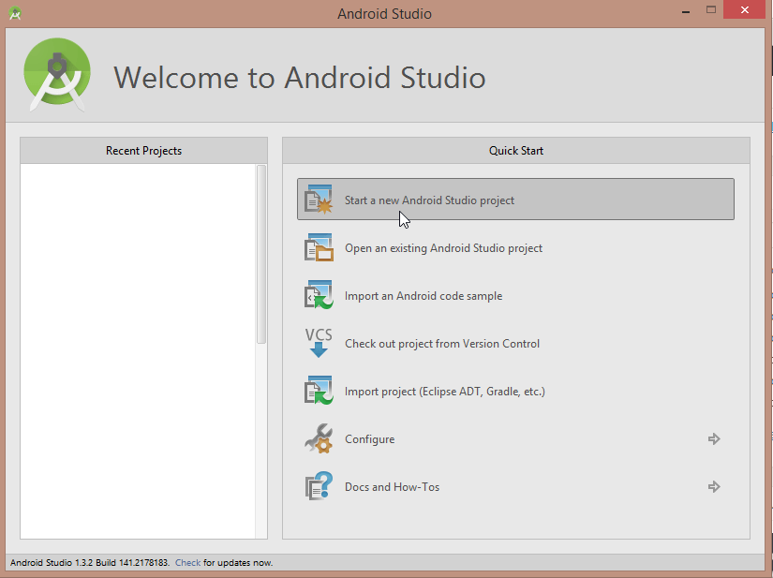
Creating Your First Android Application
Open Android Studio
Click on Start a New Android Studio Project

Slide 14
Cont..
Now you have to fill some details
The first thing is name of your application
Next is company domain, you can enter any domain it will be use to create the java packages in your project
And at last you have to choose a location in your hard drive to store your project

Slide 16
Cont..
After filling out the above details click on next
Now you have to select the minimum version of android for your application
It is by default 4.0.3 (IceCreamSandwich) that means the application you are creating will not be supported by devices having the earlier versions of android from android 4.0.3
Now Click on Next

Slide 18
Cont..
Now you have to select an Activity for your Application. In android an activity is the screen you see in the application. You can have multiple activities in your application. For now we are creating an activity.
Here you can see a number of predefined activity templates, don’t bother much we are selecting the first one which is Blank Activity.
Now click next

Slide 20
Now you will get the option to customize the Activity

Slide 21
Cont..
All the fields are filled already with default so you do not need to change anything unless you don’t want
The first thing is Activity Name: It is the name of the activity you are creating. A java file will be created with this name. You can change the name if you want but for now we are not changing the name.
Next is Layout Name: In android we separate the Layout Designing and Coding with XML and JAVA. So for your Activity’s visual design a separate layout file will be created. And what you are seeing here is activity_main this is the name of the xml file for your layout. You can also change this but the rule is you can only use small letters and underscores (_) any other characters are not allowed.
Next is Title: This is the Title which will appear at the top of your application. Usually it is our Application’s Name.
The Last is Menu Resource Name: Android studio will also create a menu resource xml file for the menu of your application. And this is the name of the menu file for your android application.
Don’t worry if you are having difficulties understanding these things we will cover this in detail in my upcoming articles
And you can also change these settings after creating the project so don’t bother much and just click on Finish.
Now wait for few minutes and you will see the following screen

Slide 23
As you can see it is already Hello World!. So now we have an app with a single activity.
Don’t bother much now we will try to cover each and everything.
Now just see how we can run our application. As I have already said we will use GenyMotion. So open GenyMotion from start menu and start your virtual device.
Now in Android Studio click on the play button from the top
Now wait for a while until don’t see the following window

Slide 25
Cont..
Now as you can see I have my Genymotion Virtual Device is running. Select the device and click on ok.
See your Virtual Device Now

Slide 27
Android Development Tutorial using Android Studio

Slide 28
Create New Project

Slide 29
You are seeing two things at number 1. The first is our app directory and the other one is our Gradle Scripts. Extract your app directory.

Slide 30
App Directory in Android Studio

Slide 31
Manifest
This directory contains AndoirdManifest.xml file. But the question is What is AndroidManifest.xml?

Slide 32
AndroidManifest.xml
In android every application must have this file. It gives the necessary system about the application to android system. AndroidManifest.xml contains Java Package name of the application
It describes the app icon, theme and label
It describes all the components of your application like, activities, broadcast receivers, services etc.
It describes all the permissions your application has to access the restrict part of android system
It also tells the minimum api level for your application
You can see the basic structure of AndroidManifest.xml by opening the file (double click to open)

Slide 33
 | <?xml version="1.0" encoding="utf-8"?> <manifest xmlns:android="http://schemas.android.com/apk/res/android" package="net.simplifiedcoding.myfirstandroidapp" > <application android:allowBackup="true" android:icon="@mipmap/ic_launcher" android:label="@string/app_name" android:theme="@style/AppTheme" > <activity android:name=".MainActivity" android:label="@string/app_name" > <intent-filter> <action android:name="android.intent.action.MAIN" /> <category android:name="android.intent.category.LAUNCHER" /> </intent-filter> </activity> </application> </manifest>
ndroidManifest.xml

Slide 34
java
The next directory you are seeing is java. It has two sub directories. If you can see the sub directories name are same as your package name. This folder contains all the java source code. You can also create new packages here to organize your java classes. But you have to touch or manipulate only the first sub directory.
The second sub directory is named package_name (androidTest). It is generated automatically.

Slide 35
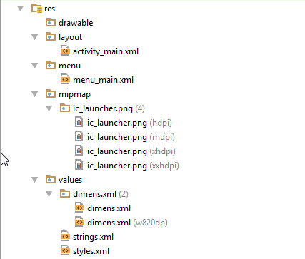
res
This folder contains all the resources for your android application. Inside this folder we have

Slide 36
drawable
Here we keep all the drawable resources like images.

Slide 37
layout
All the XML files for your activity layouts are stored here

Slide 38
menu
Menu XML files are stored here

Slide 39
mipmap
Here we can see the application icon for all screen sizes

Slide 40
values
Inside values we have a directory name dimens and two xml files named strings.xml and styles.xml
strings.xml: This file contains all the strings that will be used in our project.
styles.xml: This file contains the styles and themes for our application.
Inside the directory dimens we have two xml files that stores the margin values.

Slide 41
What is Gradle?
The basic one liner answer is: Gradle is a Build System.
Gradle takes best features of other build system and combines it to one. And because it is an JVM (Java Virtual Machine) based build system we are free to write our own script here. If you are not getting anything then don’t worry we will understand this later on in detail.

Slide 42
Creating a New Android Studio Project

Slide 43
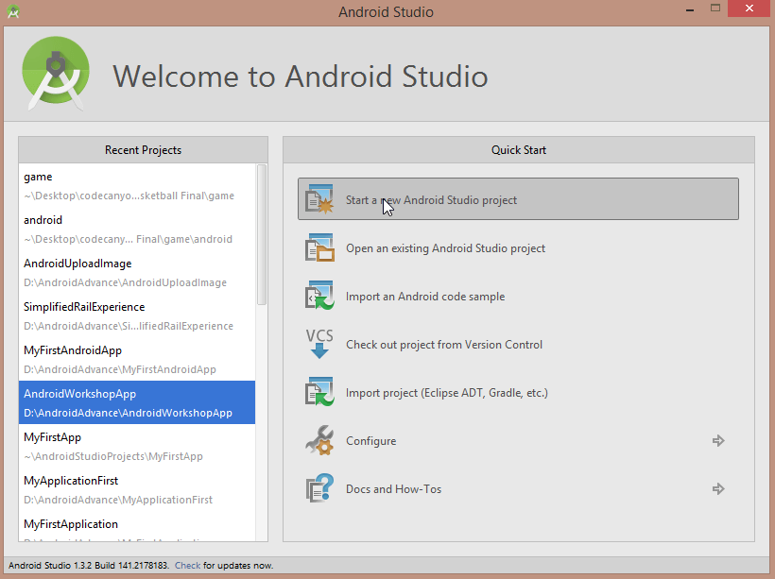
Open Android Studio and create a new project

Slide 44
Now put the put the application details (I have given the name HandlingButton) and click next
Now keep clicking next (don’t change any settings, you do not need to change anything now) and at last you will see finish

Slide 45
Finally click finish and you will see the following screen

Slide 46
Cont..
Now you are seeing your app’s screen. A default Hello World is appearing. The layout is coded in XML. You can switch to the code view from the button below. Click on Text to switch to the code view.

Slide 47
You will see the following code
 | <RelativeLayout xmlns:android="http://schemas.android.com/apk/res/android" xmlns:tools="http://schemas.android.com/tools" android:layout_width="match_parent" android:layout_height="match_parent" android:paddingLeft="@dimen/activity_horizontal_margin" android:paddingRight="@dimen/activity_horizontal_margin" android:paddingTop="@dimen/activity_vertical_margin" android:paddingBottom="@dimen/activity_vertical_margin" tools:context=".MainActivity"> <TextView android:text="@string/hello_world" android:layout_width="wrap_content" android:layout_height="wrap_content" /> </RelativeLayout>

Slide 48
Understanding the Layout
As you can see in the above code the xml tag is started with <RelativeLayout… It is a type of layout. We are many other layouts available. So what happens in RelativeLayout is all the components are aligned with relation to other components.
RelativeLayout lets child views specify their position relative to the parent view or to each other (specified by ID)

Slide 50
Cont..
 | <LinearLayout xmlns:android="http://schemas.android.com/apk/res/android" xmlns:tools="http://schemas.android.com/tools" android:layout_width="match_parent" android:layout_height="match_parent" android:paddingLeft="@dimen/activity_horizontal_margin" android:paddingRight="@dimen/activity_horizontal_margin" android:paddingTop="@dimen/activity_vertical_margin" android:paddingBottom="@dimen/activity_vertical_margin" tools:context=".MainActivity"> <TextView android:text="@string/hello_world" android:layout_width="wrap_content" android:layout_height="wrap_content" /> </LinearLayout>

Slide 51
Cont..
LinearLayout aligns all children in a single direction — vertically or horizontally, depending on how you define the orientation attribute.. So by default it will behave as horizontal LinearLayout. Now lets understand the other properties.
LinearLayout is the main tag

Slide 53
 | <LinearLayout <!-- here the layout properties are defined --> > <!-- Here we can code our other components to be put on this layout --> </LinearLayout>

Slide 54
Cont..
xmlns:android=”http://schemas.android.com/apk/res/android” -> It is the namespace for our xml.
android:layout_width=”match_parent” -> It is the width of the layout and the value is match_parent. match_parent means the width of the layout will match to the width of the parent layout. So in this case it will be the full width available.
android:layout_height=”match_parent” -> It defines the height of the layout.
The other things are padding defined. So we can have paddings at all the sides of the layout

Slide 55
Cont..
 | android:paddingLeft="@dimen/activity_horizontal_margin" android:paddingRight="@dimen/activity_horizontal_margin" android:paddingTop="@dimen/activity_vertical_margin" android:paddingBottom="@dimen/activity_vertical_margin"

Slide 56
Cont..
The value can be defined with dp (density pixels) e.g. 16dp, 18dp, 25dp etc. In the above code you are seeing the values are not defined in dp. It is actually dp but the value is defined inside another xml file called dimens.xml.

Slide 57
Creating Views Inside Layout
Inside the layout we can create the views for our application. Views are the widgets and components like Buttons, EditTexts (Text Fields) and many other components which will be used for creating our application.
In this post we will be learning how to create a Button and an EditText. We now what is a Button and an EditText. We can use EditText to take input from user and Button to perform some action on tap.

Slide 58
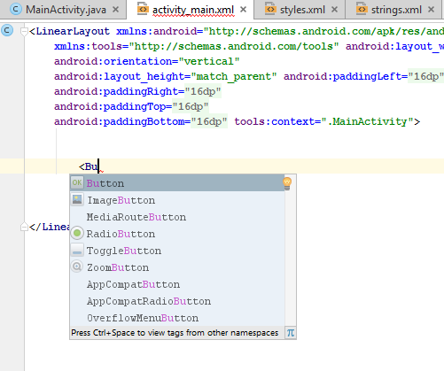
Creating a Button
For creating a button we can use Button tag
Just go inside the layout and type <Button

Slide 59
Cont..
You will get a dropdown now press enter. Now you can set the width and height for you button. You see the xml code for a button below.
 | <Button android:id="@+id/button" android:layout_width="wrap_content" android:layout_height="wrap_content" android:text="This is a button" />

Slide 60
Cont..
android:id=”@+id/button”: This is the id for your button after @+id/ i.e. here the id for your button is “button” (without quotes). This id will be used to handle the button in java coding. Whenever we put@+id in android:id tag of any view a respective hex value is stored in a variable named with the id you have given here in R.java file. Now these things are done automatically so you do not need to bother much about this. Basically what you need to know is this is the id that will be used for handling this button.
Now we will create an Edit Text. For creating Edit Text we have the tag <EditText

Slide 61
Cont..
 | <EditText android:id="@+id/editText" android:layout_width="match_parent" android:layout_height="wrap_content" />

Slide 62
The code for the final layout that we have created yet is.
 | <LinearLayout xmlns:android="http://schemas.android.com/apk/res/android" xmlns:tools="http://schemas.android.com/tools" android:layout_width="match_parent" android:orientation="vertical" android:layout_height="match_parent" android:paddingLeft="@dimen/activity_horizontal_margin" android:paddingRight="@dimen/activity_horizontal_margin" android:paddingTop="@dimen/activity_vertical_margin" android:paddingBottom="@dimen/activity_vertical_margin" tools:context=".MainActivity"> <Button android:id="@+id/button" android:layout_width="wrap_content" android:layout_height="wrap_content" android:text="This is a button" /> <EditText android:id="@+id/editText" android:layout_width="match_parent" android:layout_height="wrap_content" /> </LinearLayout>
ndroid app development tutorial

Slide 63
Now if you will switch to the design view you will see something like this
So as you can see we have our Button and EditText.
We could have done the same thing by simple drag and drop using the palette

Slide 65
Moving on to Java Coding

Slide 66
Open MainActivity.java

Slide 67
MainActivity.java
Java
After opening MainActivity.java you will see the following code

Slide 68
1 2 3 4 5 6 7 8 9 10 11 12 13 14 15 16 17 18 19 20 21 22 23 24 25 26 27 28 29 30 31 32 33 34 35 36 37 38 | package net.simplifiedcoding.handlingbutton; import android.support.v7.app.AppCompatActivity; import android.os.Bundle; import android.view.Menu; import android.view.MenuItem; public class MainActivity extends AppCompatActivity { @Override protected void onCreate(Bundle savedInstanceState) { super.onCreate(savedInstanceState); setContentView(R.layout.activity_main); } @Override public boolean onCreateOptionsMenu(Menu menu) { // Inflate the menu; this adds items to the action bar if it is present. getMenuInflater().inflate(R.menu.menu_main, menu); return true; } @Override public boolean onOptionsItemSelected(MenuItem item) { // Handle action bar item clicks here. The action bar will // automatically handle clicks on the Home/Up button, so long // as you specify a parent activity in AndroidManifest.xml. int id = item.getItemId(); //noinspection SimplifiableIfStatement if (id == R.id.action_settings) { return true; } return super.onOptionsItemSelected(item); } }

Slide 69
Cont..
Now don’t worry if it is bouncing over your head :P. We will understand every line. Everytime you will create a project the above given snippet would generate automatically.
So in the above code we have a class MainActivity. Inside the class we have three overriden methods. Leave the first method and delete the remaining two methods (onCreateOptionMenu and onOptionsItemSelected). After deleting the methods you will have the following code.

Slide 70
MainActivity.java
1 2 3 4 5 6 7 8 9 | public class MainActivity extends AppCompatActivity { @Override protected void onCreate(Bundle savedInstanceState) { super.onCreate(savedInstanceState); setContentView(R.layout.activity_main); } }

Slide 71
Understanding the Above Code
MainActivity: It is the name of the class we are having. It is also named as your activity name. If you remember the project creation we have given this name.
AppCompatActivity: Our class MainActivity is extending this class.
onCreate(Bundle savedInstanceState): This is an overridden method. It is inside the AppCompatActivity class. This method will be executed when the app is opened (the activity is created). So basically you can think that it is the main method.

Slide 72
Cont..
Bundle: It is another predefined class. It is basically used for passing data between android activities.
setContentView(R.layout.activity_main): This method takes a layout and it set the view as the layout to the activity. We created a layout named activity_main.xml. As I told you before that all the ids for all the components are generated automatically and stored inside R.java file. And that is what we are doing here. We are selecting the id of our layout from R.java file (R.layout.activity_main).

Slide 73
The above mentions things are generated automatically. Now we need to code our things. So the layout we created is having a Button and an EditText. We have predefined classes in android for all the compnents. So now come inside the MainActivity class.

Slide 74
Cont..
We will declare two instances one for Button and one for EditText
.
MainActivity.java
1 2 3 | public class MainActivity extends AppCompatActivity { private Button button; private EditText editText;

Slide 75
Now if you are getting error as shown in the below image
This error is caused because you haven’t imported the packages. So just put the cursor in the word causing error. In my case it is EditText.

Slide 76
Press alt+enter
Click on import class. And you’ll see your error has gone away.
Now we have the instances for our Button and EditText
Now we will initialize our instances inside the onCreate method.

Slide 77
Initializing a View
All these components Button and EditText are called View. We have also a predefined class named View in android. For initializing a View from XML layout file, we have a method findViewById().

Slide 78
findViewById(int id)
It takes a parameter id. As I told you that every components has an specific id that is stored in R.java file. So we will provide the id from the R file. We don’t need to go to the R file actually it is the id we have given while creating the component. And with the name of the id a variable is created inside the R file with a unique hex value. So lets initialize our components.
Come inside onCreate() method and write the following code

Slide 79
If you are also getting the error then don’t worry. We are getting the error because the method findViewById() returns a View. But in left side we are having a Button. So the error is because of the type mismatch. Put the cursor in the line and press alt+enter

Slide 80
Click on Cast to android.widget.Button
So now the error has gone. So everytime we need to cast to the respective view if we are using findViewById() method.
So now our onCreate() method would be

Slide 81
Oncreate()
1 2 3 4 5 6 7 8 | @Override protected void onCreate(Bundle savedInstanceState) { super.onCreate(savedInstanceState); setContentView(R.layout.activity_main); button = (Button) findViewById(R.id.button); editText = (EditText) findViewById(R.id.editText); }
So we have initialized our button and editText. So what I will be doing from here is I will get an given name from the editText and will show a greeting message in the same editText.

Slide 82
Cont..
So for this I will create a separate method. So create a method named showMessage().
1 2 3 | private void showMessage(){ }
Now for manipulating our editText we will use the method getText() and setText()

Slide 83
Handling EditText
getText(): This method returns an Editable instance. And it contains the text from the EditText. So for storing the Text into a String object, we can use the toString() method to convert it into String.
setText(String s):This method takes a string and set the string to EditText.
So using the above methods we can code our method showMessage().

Slide 84
Cont..
1 2 3 4 5 | private void showMessage(){ String s = editText.getText().toString(); String greeting = "Hello "+s; editText.setText(greeting); }
Now this method should execute when the user will tap on the button.

Slide 85
Using Android OnClickListener Interface
We have an Interface OnClickListener inside the View class. This interface can be used for handling the button. So first implement this interface into your MainActivity class.
We are getting an error this is because we have implemented the interface OnClickListener but we did not override the methods inside the interface OnClickListener.

Slide 86
Now put the cursor on the line and press alt+enter
Click on Implement methods

Slide 87
Now select onClick() and click OK.
Now you will see the following method in your MainActivity class.
Now select onClick() and click OK.

Slide 88
Now you will see the following method in your MainActivity class.
1 2 3 4 | @Override public void onClick(View v) { }
This method will be executed on button tap but before we have to specify the listener for our button. We can do this using setOnClickListener() method

Slide 89
Cont..
setOnClickListener(View.OnClickListener l)
This method takes the reference to the Listener and registers a callback to be invoked when the View is clicked.
So we have the listener in the same class MainActivity. So we can pass the reference using this. So write the following code inside onCreate().

Slide 90
Now after doing this our overriden method onClick() will execute when the button is tapped. So now we can call our method showMessage() inside onClick()

Slide 91
1 2 3 4 | @Override public void onClick(View v) { showMessage(); }
So the final code we are having is

Slide 92
1 | public class MainActivity extends AppCompatActivity implements View.OnClickListener { private Button button; private EditText editText; @Override protected void onCreate(Bundle savedInstanceState) { super.onCreate(savedInstanceState); setContentView(R.layout.activity_main); button = (Button) findViewById(R.id.button); editText = (EditText) findViewById(R.id.editText); button.setOnClickListener(this); } private void showMessage(){ String s = editText.getText().toString(); String greeting = "Hello "+s; editText.setText(greeting); } @Override public void onClick(View v) { showMessage(); } }

Slide 93
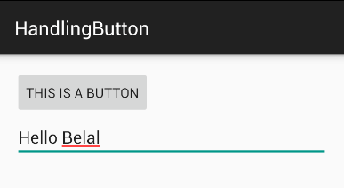
Now run your application
Enter your name in the EditText and Tap on the Button. You will see the greeting message in EditText. So I wrapping up this Android OnClickListener tutorial here. In the next tutorial we will see some more methods to Handle our button.

